Slide 2
Notes:
Both – Tom starts and discusses book we wrote together

Slide 3
Notes:
Tom

Slide 4
Evolving Language: Community, Diversity, Inclusivity
LGBPTQ2SIA+ :
Lesbian
Gay
Bisexual and Pansexual
Transgender (Genderqueer, Non-binary, Genderfluid, Agender)
Queer
Two-Spirited
Intersex
Asexual (Ace, Demi, Aromantic)
Notes:
Robin

Slide 5
Notes:
Tom (ask audience – why are you here?)

Slide 6
Notes:
Tom (it all boils down to representation)

Slide 7
Why Representation Matters
“Books are sometimes windows, offering views of worlds that may be real or imagined, familiar or strange. These windows are also sliding glass doors, and readers have only to walk through in imagination to become part of whatever world has been created or recreated by the author. When lighting conditions are just right, however, a window can also be a mirror. Literature transforms human experience and reflects it back to us, and in that reflection we can see our own lives and experiences as part of the larger human experience. Reading, then, becomes a means of self-affirmation, and readers often seek their mirrors in books.”
–Rudine Sims Bishop (Professor Emerita of Education, Ohio State University, African American children’s literature specialist, 1990
Notes:
. Robin

Slide 8
LGBTQ+ inclusive books can: -reduce sense of isolation -counter negative stereotypes and misinformation -normalize queer family structures -affirm identity -educate about LGBTQ history, identity and community -offer hope for future -save lives- literally.
Notes:
Tom (add personal)

Slide 9
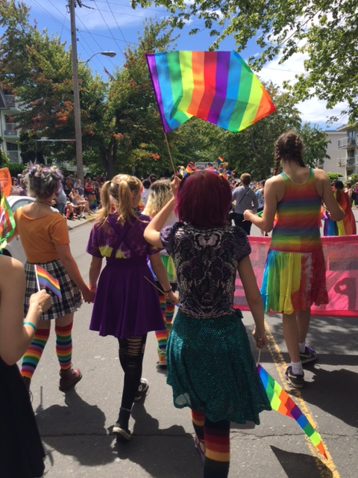
LGBTQ+ Inclusive Books Aren’t Just For LGBTQ+ Readers
Realism: Literature should reflect the diversity of our world
LGBTQ people still very much underrepresented in fiction
Understanding leads to empathy, which leads to concern for equality and social justice
Notes:
Robin

Slide 10
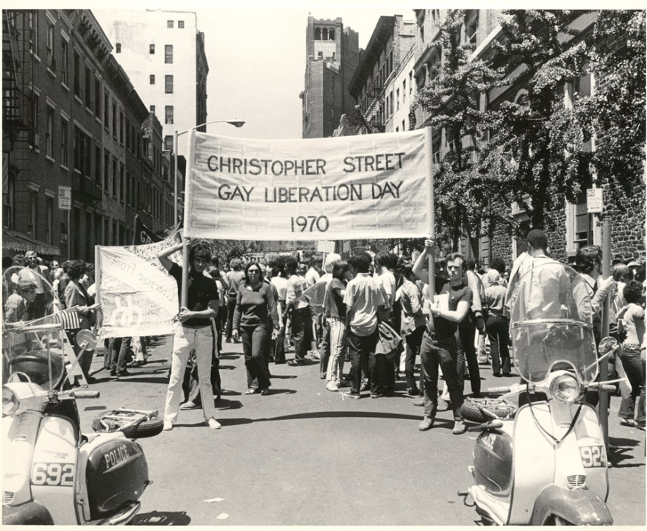
A LOT HAS CHANGED OVER THE PAST SEVERAL DECADES…
Notes:
Tom (we just passed 50th anniversary of Stonewall)

Slide 11
THEN
Notes:
Robin

Slide 12
Notes:
Tom

Slide 13
Notes:
Tom

Slide 14
Notes:
RObin

Slide 15
Notes:
Robin (any to share with the group?)

Slide 16
Beyond the G in LGBTQ2SIA+
Notes:
Tom
Trans, asexual, genderfluid, bisexual

Slide 17
Complex Identities: Intersectionality
Notes:
Robin

Slide 18
Beyond Contemporary Realism: Multiple Genres
Notes:
Tom

Slide 19
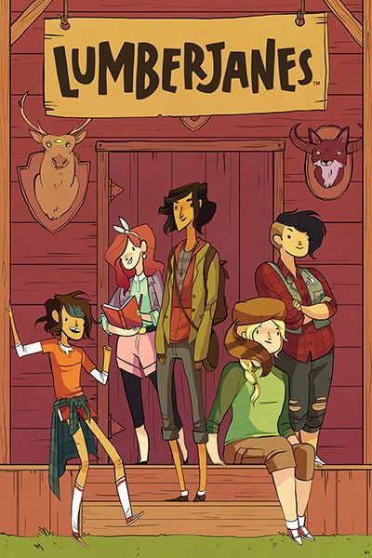
Not Just For Teens: LGBTQ Middle-Grade Books
Notes:
Tom

Slide 20
Board Book, Picture Book, Middle Grade, YA?
What kind of stories are of interest to this age group?
How might that intersect with LGBTQ+ issues? Examples.
Notes:
Robin

Slide 21
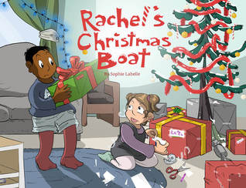
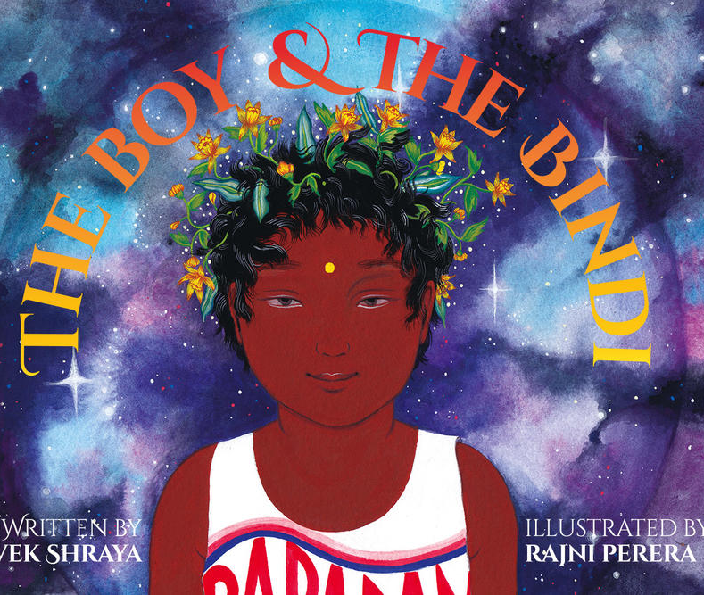
Books for the Youngest Readers: Normalizing Queer Families, Queer Identities, and Gender Creativity
Notes:
Robin

Slide 22
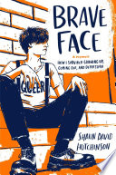
Whose Story is it Anyway? #OwnVoices
Notes:
Tom

Slide 23
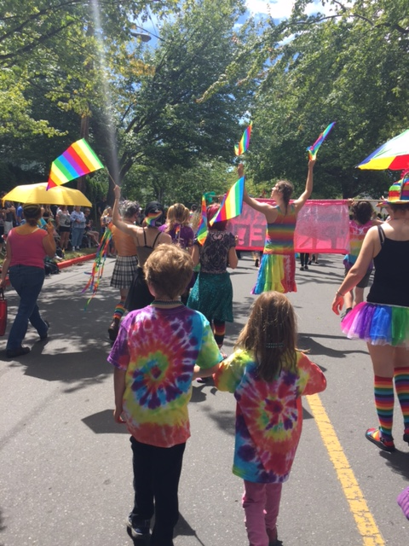
Questions & Discussion

